Slide 1
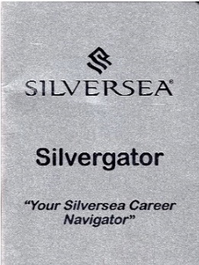
DELIVERING PROFESSIONAL APPRAISALS
Mandatory training for all onboard Management
Notes:
Prepare in advance in a suitable training location e.g. Theatre, conference room ... Have this slide on the screen as attendees enter
Please arrange coffee, pastries, paper, pens and all printouts in advance
Print a copy of the appraisal document for each attendee
You must follow the Silvergator policy

Slide 2
INDEX
1
2
3
4
5
6
Why
When
Who
Where
What
How
Notes:
Explain that this training will take approx. 1 hour and will discuss why we deliver appraisals, when we deliver appraisals, who is involved in the appraisal process, where the appraisal conversation must take place, what the appraisal document contains and how to complete the appraisal

Slide 3
WHY
Why do we conduct appraisals?
Notes:
Ask the group why we conduct appraisals.
Listen to their answers and discuss.

Slide 4
Give honest, constructive feedback
Support Management decisions e.g. promotion
WHY
Set targets
Highlight required actions
Identify training and development needs
To receive employee feedback
Give formal, documented feedback
Motivate
Record performance and development
Encourage and support development
Notes:
Ask the group why we conduct appraisals.
Listen to their answers and discuss.

Slide 5
WHY
Why do we conduct appraisals?
To achieve the best possible work performance from our crew
Notes:
Advise that the main reason for conducting appraisals is to get the best possible work performance from our crew and support them to achieve their potential

Slide 6
WHY
Why do we conduct appraisals?
It is our job as Silversea leaders to unlock the potential of our crew
Notes:
Advise that the main reason for conducting appraisals is to get the best possible work performance from our crew and support them to achieve their potential

Slide 7
DELIVERING PROFESSIONAL APPRAISALS
“
Good, better, best
Never let it rest
Until your good is better
And your better is best
“
Notes:
Even our best crew can be better, there are always training and development requirements to be noted even for the best performers

Slide 8
WHEN
30 days
Interim
Sign off
Line Manager
Sign off
Every new crew member must receive a 30 day appraisal
The probationary period for non-Filipino crew is still 90 days
You do not need to make a probation decision at 30 days
Due to high performance
To recommend for promotion or position change
(For poor performance we use the Performance Improvement Notice (PIN)
3 days before sign off
End of contract
Medical debark
Transfer to another vessel
Resignation
Termination of contract
*Not for dismissal as the crew member will automatically have a ‘no-re-hire’ status
All appraisals due within one month
Appraise all Managers/supervisors providing you have worked with them for 30 days
Questions?
Notes:
Explain when we are required to conduct appraisals.
Stress that 30 day appraisals are also for crew who are new to the position (this is often forgotten)

Slide 9
DELIVERING PROFESSIONAL APPRAISALS
“
We all need people that give us feedback
That’s how we improve
Bill Gates
“
Notes:
Explain that feedback is a gift and as a Manager, your team need your feedback.

Slide 10
WHO
Who completes the appraisal document?
Who is present at the appraisal meeting?
Who signs the document?
Who receives the document?
Direct Line Manager
Appraisal reviewed by HD, F&B (If applicable) and HRM
Shoreside review as per ‘Who Appraises Whom’ document
Line Manager
Crew Member
HRM if required
Crew Member
Line Manager
Department Head
Line Manager scans the completed, signed document and sends to the HR Manager
Line Manager gives the original back to the crew member
HR Manager sends all appraisals to the Crew Mgr, Fleet T&D Mgr and corporate Mgr (If applicable)
Questions?
Notes:
Discuss who carries out the appraisal.
Explain that it is vital that every appraisal is sent to the HRM and department head for checking before issuing to the crew member.
Explain that HRM does not sign the document and that a scanned copy must be sent to the HRM in order for them to collate all appraisals and send to the crewing team.
Explain that the Line Manager is responsible for returning the original appraisal to the crew member (in a labelled envelope).

Slide 11
DELIVERING PROFESSIONAL APPRAISALS
“
The leaders who get the most out of their people are the leaders who care most about their people
Simon Sinek
“
Notes:
Explain that everyone is capable of given excellent feedback to their team and delivering professional, constructive appraiasals; the most important thing is that we care enough to do so.

Slide 12
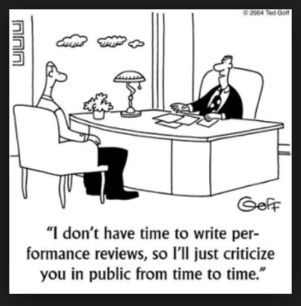
WHERE
Where do we hold appraisal meetings?
Yes – ‘appraisal meetings’ ... We discuss the appraisal with the employee in a meeting, we never just give the document to the crew member
The meeting must be scheduled in a private, professional location without disruptions e.g. An office or meeting room
Not within earshot of others
Crew member should sit closest to the door
Notes:
Advise the group that appraisals are to be delivered professionally in a professional environment with no disruptions

Slide 13
DELIVERING PROFESSIONAL APPRAISALS
“
Every good conversation starts with listening
Tom Haak
“
Notes:
Appraisals must be delivered in an environment where quality, two-way conversation can take place

Slide 14
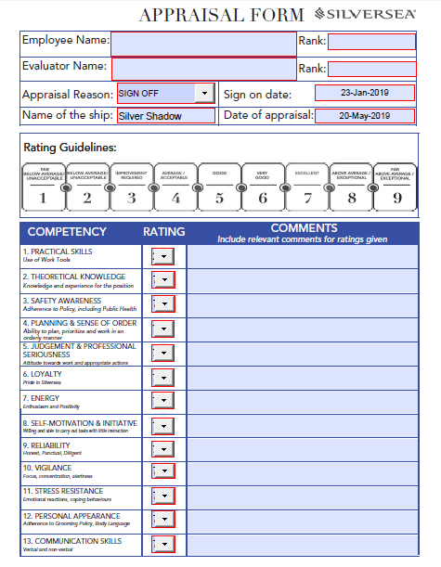
WHAT
What is a Silversea Appraisal
The Silversea appraisal document is two pages long
The first page includes performance requirements with ratings defined by a number between 1 and 9 (1 being lowest and 9 highest)
The first page allows for comments *relevant comments must be included especially for a rating of 1, 2, 8 or 9
The second page allows for additional comments, training and development recommendations, key achievements and signatures
Notes:
Hand out the Silversea appraisal document and allow time for each attendee to view the document

Slide 15
WHAT
What is a Silversea Appraisal?
Notes:
Talk step by step through the appraisal document.

Slide 16
HOW
How do we carry out appraisals?
Notes:
Handout – ‘How do we carry out appraisals’
Allow time for each attendee to read the document. Some content has already been discussed as part of the training so just highlight any points that you have not already discussed.
Stress the importance of preparing in advance and following the timeline.
Ask if anyone has any questions.

Slide 17
HOW
How do we give constructive feedback?
Feedback must be useful and beneficial
There must be a positive reason for discussing the feedback e.g. to improve service for our guests
Allow the person to suggest their own solutions rather than simply telling them what to do
Give any feedback with respect and offer support
Use the sandwich approach; give positive feedback followed by constructive feedback ending with further positive feedback.
Don’t be overly critical; remember the aim is to support improvement not to upset the person
Be specific about what it is that needs to be improved and be reasonable in your expectations.
Advise of a measure of success and if possible, set a deadline for the improvement as well as advising what support will be given in that time frame.
Notes:
Ask the group if they are comfortable giving constructive feedback.
Ask if they have any advice for each other on how to deliver constructive feedback.
Discuss the bullet points if not already mentioned

Slide 18
HOW
Bad leader
Good leader
Appraisals are a waste of time
Appraisals are a nuisance
This is just more paperwork
I’m signing off soon, better prepare my appraisals
She is really not performing, I will support her with a PIN
What a great opportunity to give feedback
I’ll just score all 5’s and not write anything
I’ll just leave it for the next guy
I’ll schedule time to do this properly
Appraisals are a valuable tool
Notes:
Read the comments on the slide in an impactful manner
Ask the group to just think if they relate to any of the traits of the ‘bad leader’ or ‘good leader’

Slide 19
HOW
Halo effect
Horns effect
Recency effect
Avoid giving undeserved positive appraisals due to one trait
Avoid giving undeserved negative appraisals due to one trait
Avoid appraising only recent actions; review the whole contract/time together
Questions?
Notes:
Explain the horns, halo and recency effect – these could be deemed as discrimination e.g. Good or bad appraisals because of gender, secuality, nationality ...

Slide 20
DELIVERING PROFESSIONAL APPRAISALS
“
We are what we repeatedly do
Excellence then, is not an act, but a habit
Aristotle
“
Notes:
Advise the group that when they are appraising an employee, think about the consistency of their actions. One act does not make someone excellence. One wrongdoing does not make someone a failure. Consider the whole contract/time spent together.

Slide 21
DELIVERING PROFESSIONAL APPRAISALS
“
Everybody is a genius
But if you judge a fish by its ability to climb a tree,
It will spend its whole life believing that it is stupid
Albert Einstein
“
Notes:
Explain that we can only appraise on requirements of the job description for that position
Explain that you can refer to the job description for guidance

Slide 22
DELIVERING PROFESSIONAL APPRAISALS
Questions?
Test your knowledge ...
Notes:
Ask the group if they have any questions
For the final activity, ask the attendees to work alone to answer the questions on the sheet. Then go through the answers
If you are running out of the time, send the quiz out after the training for return via email within 1 day.

Slide 23
Don’t forget
your Silvergator
Delivering Professional Appraisals
Notes:
Handout the examples sheet to support managers in writing appraisals going forward. There is no need to read through this sheet but Managers can come to youwith any queries afterwards.
Ensure that you sign silvergators, Ensure that you save a signed attendance sheet, Record the training in your voyage report
Send the completed ‘test your knowledge’ sheets to the Fleet Training and Development Manager

